Slide 1


Data 620 WK1 Part II Hello Graph World
Group 6
Jun Pan
06-03-2019

Slide 2
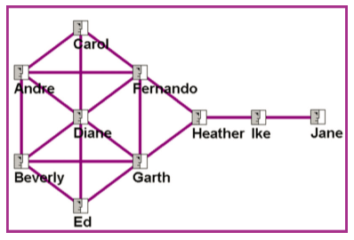

create the nodes and edges for a basic graph

Slide 3


Setup Working Environment
NetworkX is a Python package for the creation, manipulation, and study of the structure, dynamics, and functions of complex networks.
Matplotlib is a collection of command style functions that make matplotlib work like MATLAB.

Slide 4

Set an Empty Graph G

Slide 5
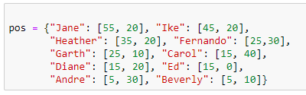
Define Position of Nodes

Slide 6

Add Nodes

Slide 7
Add Edgers

Slide 8
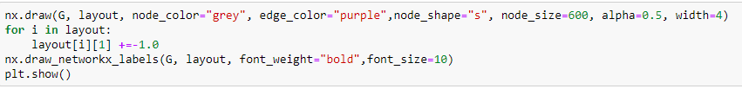
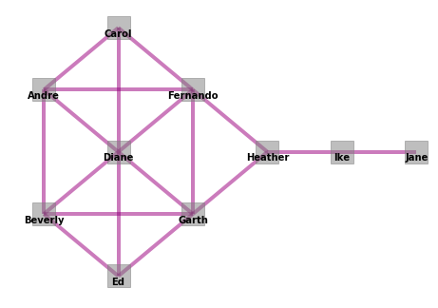
Draw Graph

